Slide 1

Speech recognition with Arduino
Presented By : The Assembly Team

Slide 2
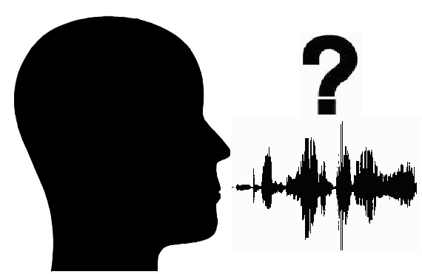
Introduction
What is speech recognition?
Speech recognition is the ability of a program or computer to interpret speech and convert it to a format understood by machines.
Very easy to implement, and makes life more convenient.
Applications include:
Cortana
Siri

Slide 3
In today’s workshop
Use an app designed by MIT app inventor to input voice commands.
The app inventor has an inbuilt speech recognizer, which converts spoken speech to text.
Using Bluetooth, this text is sent to the Arduino.
Based on what is received by the Arduino, the corresponding action takes place. For instance, when we say “blue on”, this text is sent to the Arduino using Bluetooth, and so the Arduino triggers the blue LED to activate.

Slide 4
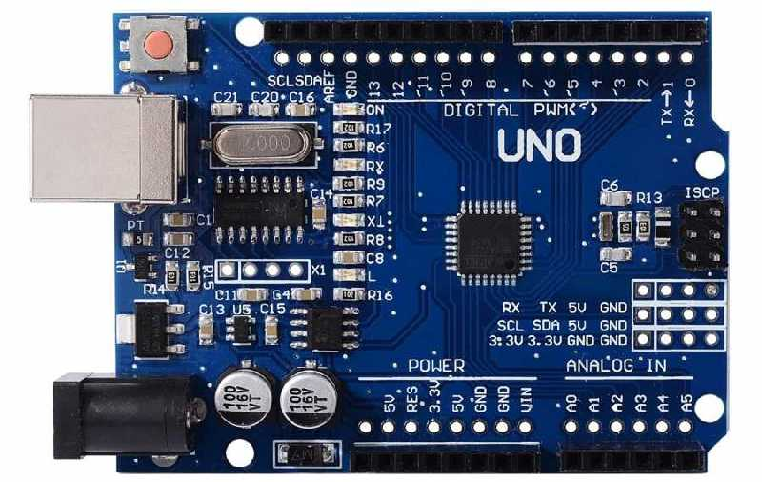
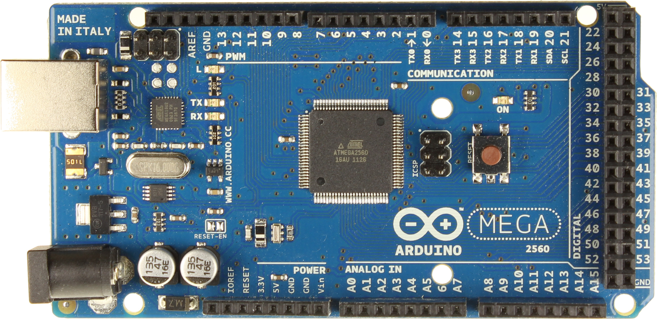
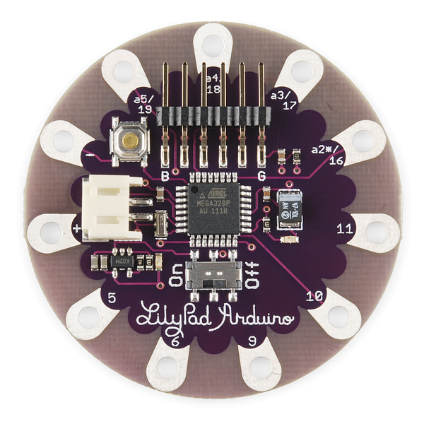
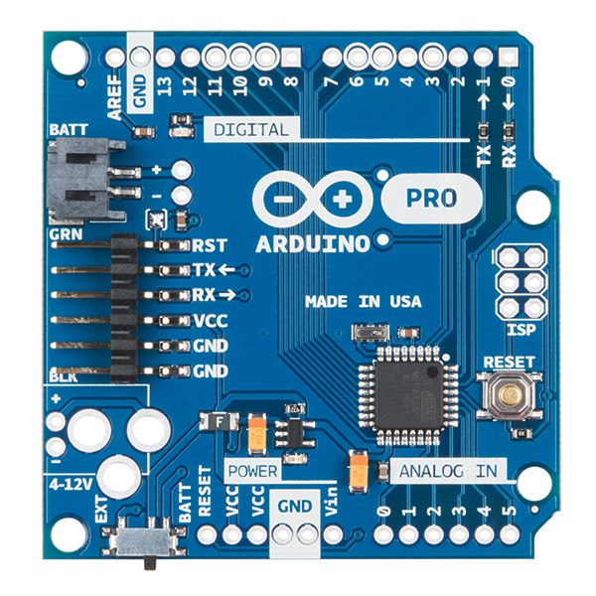
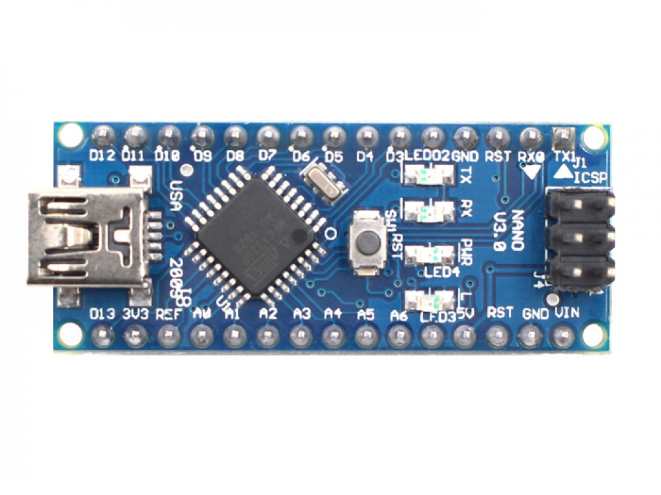
The Arduino
Notes:
Main Website - https://www.arduino.cc/
Introduction to Arduino - https://www.arduino.cc/en/Guide/Introduction
Arduino vs Raspberry PI - https://makezine.com/2015/12/04/admittedly-simplistic-guide-raspberry-pi-vs-arduino/ ; https://circuitdigest.com/article/arduino-vs-raspberryp-pi-difference-between-the-two
Arduino IDE - https://www.arduino.cc/en/Main/Software ; https://www.arduino.cc/en/Guide/Environment
Arduino compare - https://learn.sparkfun.com/tutorials/arduino-comparison-guide

Slide 5
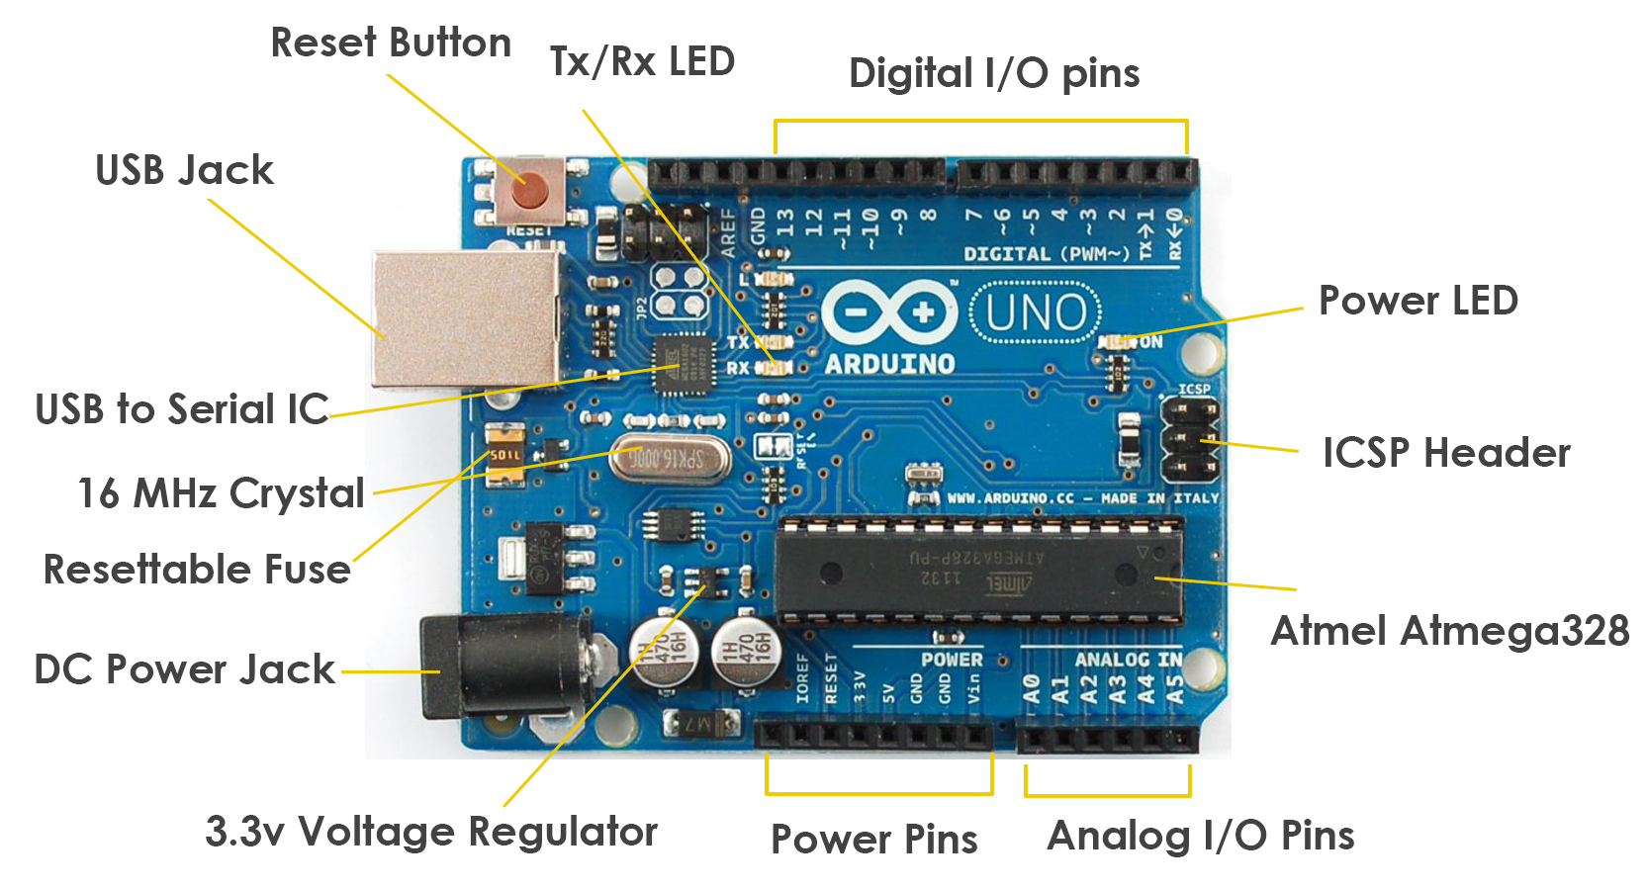
Arduino UNO
Notes:
Arduino UNO- https://www.arduino.cc/en/Main/ArduinoBoardUno/ ; http://forefront.io/a/beginners-guide-to-arduino/

Slide 6
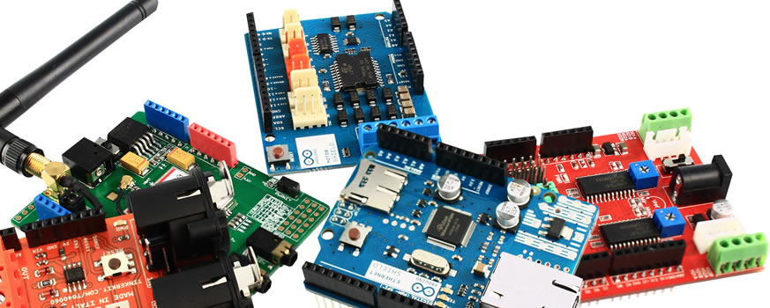
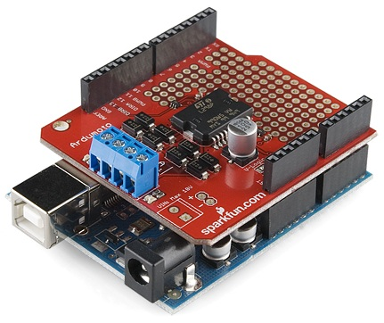
Arduino Shields
Notes:
Arduino Shields - https://randomnerdtutorials.com/25-arduino-shields/ ; https://randomnerdtutorials.com/25-arduino-shields/
Sparkfun Shields - https://www.sparkfun.com/categories/240?page=all
Adafruit Shields - https://www.adafruit.com/category/21
Tutorials - https://learn.sparkfun.com/tutorials/arduino-shields

Slide 7
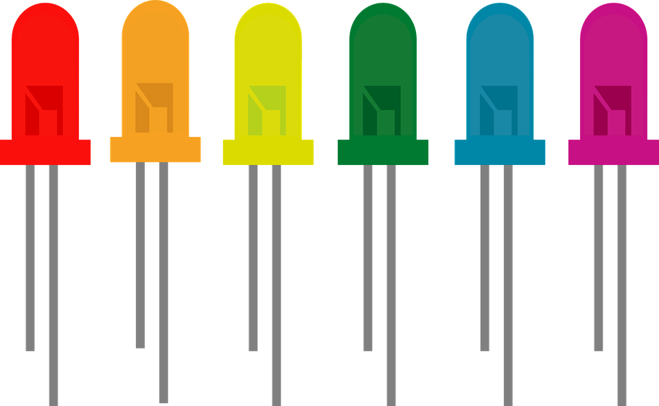

Light Emitted Diode
A particular type of diode that convert electrical energy into light.
Longer end -> positive end (anode)
Shorter end -> negative end (cathode)
Notes:
*The key function of an ideal diode is to control the direction of current-flow. Current passing through a diode can only go in
one direction, called the forward direction.
Read more https://learn.sparkfun.com/tutorials/light-emitting-diodes-leds
http://whatis.techtarget.com/definition/light-emitting-diode-LED

Slide 8
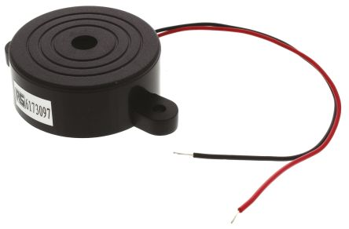
Piezo Buzzer
Electronic device commonly used to produce sound
Light weight, simple construction and low price
Piezo electricity
Piezoceramic disks
Notes:
Read more http://www.futureelectronics.com/en/passives/buzzers.aspx
Tutorial - http://www.instructables.com/id/How-to-use-a-Buzzer-Arduino-Tutorial/
*Piezo electricity - phenomena of generating electricity when mechanical pressure is applied to certain materials and the vice versa is also true. Such materials are called piezo electric materials. Piezo electric materials are either naturally available or manmade.
*Piezoceramic disks - Piezoceramic is class of manmade material, which poses piezo electric effect and is widely used to make disc, the heart of piezo buzzer. When subjected to an alternating electric field they stretch or compress, in accordance with the frequency of the signal thereby producing sound.

Slide 9
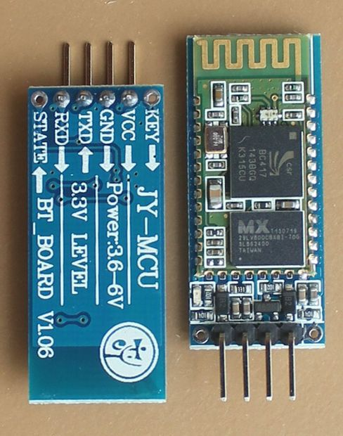
HC-06 Bluetooth Module
Notes:
Read more http://www.fecegypt.com/uploads/dataSheet/1480849570_hc06.pdf
Tutorial - http://www.instructables.com/id/Add-bluetooth-to-your-Arduino-project-ArduinoHC-06/
*AT mode can be activated to change the default settings of the Bluetooth module

Slide 10
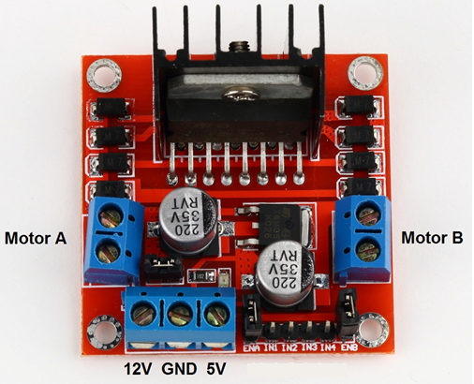
L298N Motor Driver
L298N Dual H-Bridge Motor Controller module
H-Bridge's are typically used in controlling motors speed and direction
An H-Bridge is a circuit that can drive a current in either polarity and be controlled by Pulse Width Modulation (PWM)
Why use a motor drive ?
Notes:
Read more http://www.geeetech.com/wiki/index.php/L298N_Motor_Driver_Board
Tutorial http://www.instructables.com/id/Control-DC-and-stepper-motors-with-L298N-Dual-Motor/
*H-Bridges can also be used for other projects such as driving the brightness of certain lighting projects such as high powered LED arrays.
*Pulse Width Modulation is a means in controlling the duration of an electronic pulse
*Motors are rated at certain voltages and can be damaged if the voltage is applied to heavily or if it is dropped quickly to slow the motor down.
The longer the pulses the faster the wheel will turn, the shorter the pulses, the slower the water wheel will turn.

Slide 11
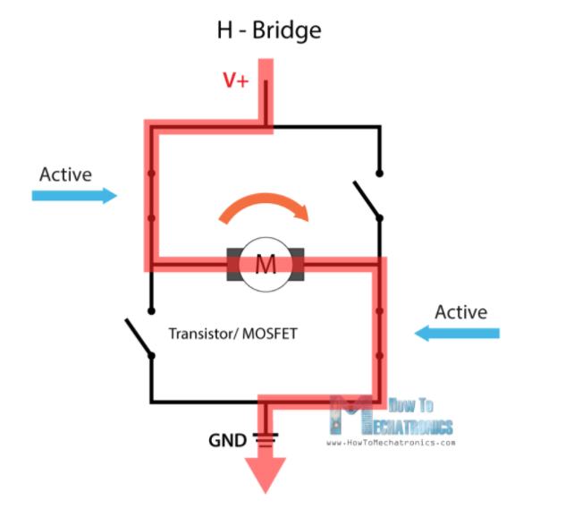
H-bridge
Notes:
*H-Bridges can also be used for other projects such as driving the brightness of certain lighting projects such as high powered LED arrays.

Slide 12
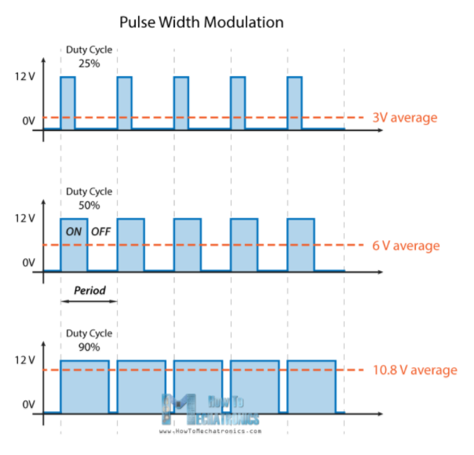
Pulse Width modulation (PWM)
Notes:
*Pulse Width Modulation is a means in controlling the duration of an electronic pulse
*Motors are rated at certain voltages and can be damaged if the voltage is applied to heavily or if it is dropped quickly to slow the motor down.
The longer the pulses the faster the wheel will turn, the shorter the pulses, the slower the water wheel will turn.

Slide 13
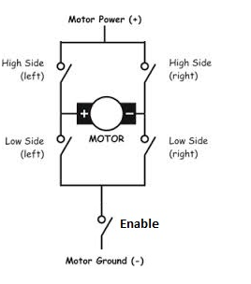
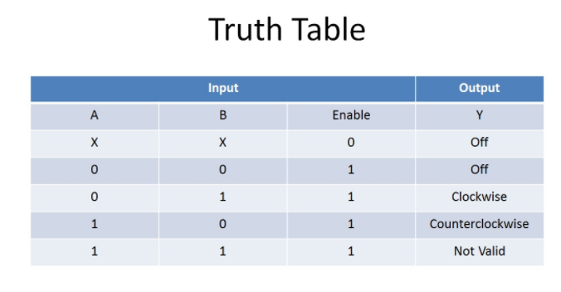
H-bridge with PWM

Slide 14
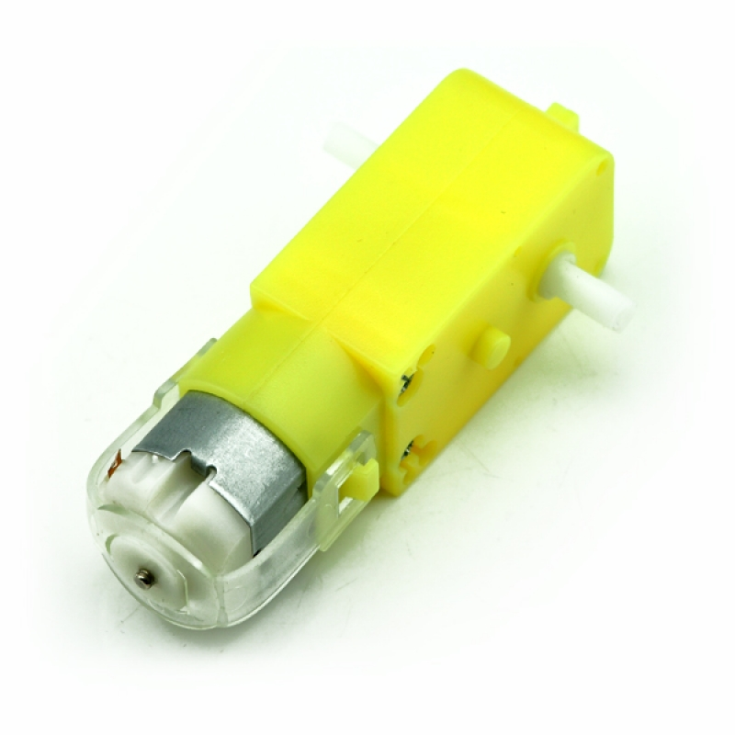
Geared DC motor
What is a gear motor?
How do the gears work ?
Applications - can openers, garage door openers and washing machine
How is it different from a normal dc motor?
Notes:
Read more https://www.doityourself.com/stry/how-a-gear-motor-works
*A gear motor is a specific type of electrical motor that is designed to produce high torque while maintaining a low horsepower, or low speed, motor output.
They are primarily used to reduce speed in a series of gears, which in turn creates more torque.
*A DC motor is not the same as a "gear motor" - a "gear motor" may be an AC or DC motor coupled with a gearbox. A gear motor adds mechanical gears to alter the speed/torque of the motor for an application. Usually such an addition is to reduce speed and increase torque.

Slide 15
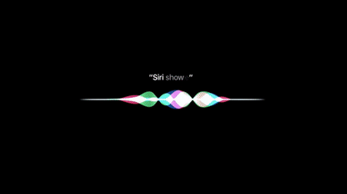
Let’s Begin
Let’s Begin

Slide 16
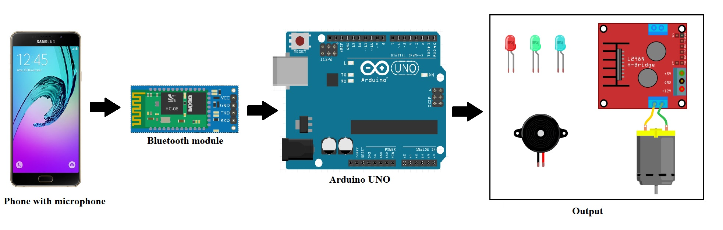
Overview of the Process

Slide 17
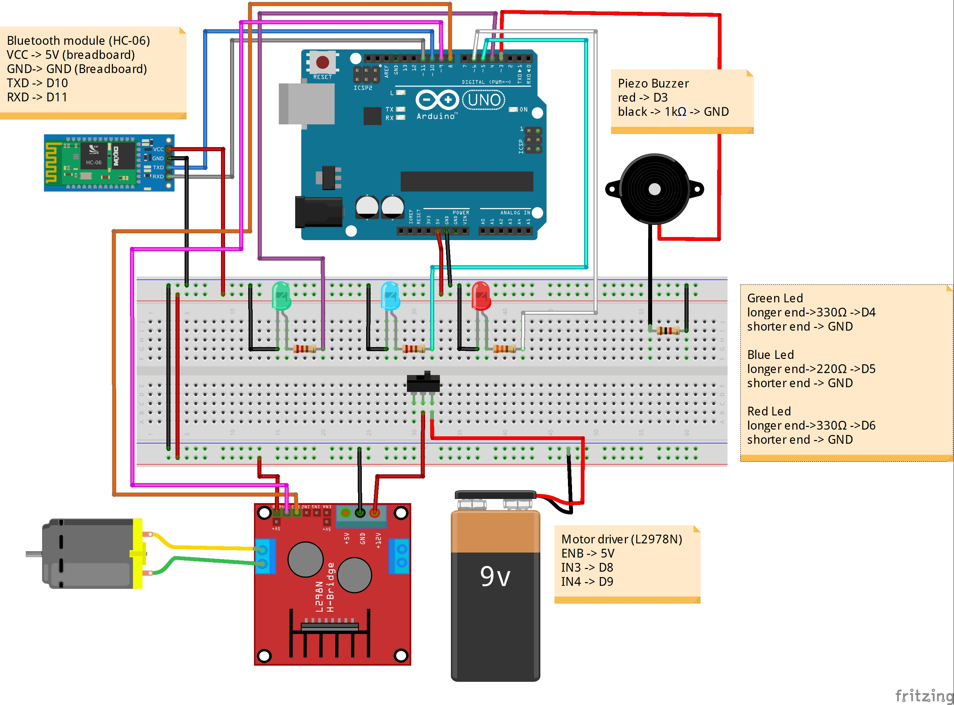
The Circuit Diagram

Slide 18
Code
Download the Arduino IDE
Download the Arduino code, app code (.aia) and libraries file from : https://github.com/The-Assembly/Voice_regonition_arduino

Slide 19
Code
Open the MIT app inventor from: http://ai2.appinventor.mit.edu
To access the code, click Projects > Import selected projects from my computer, and select the .aia file downloaded
To run the app on Android Device, click Build > Provide QR code for .apk, and use QR code scanner on device to scan it.
Connect to the HC026 Bluetooth with your phone by pressing “Bluetooth” on phone screen.

Slide 20
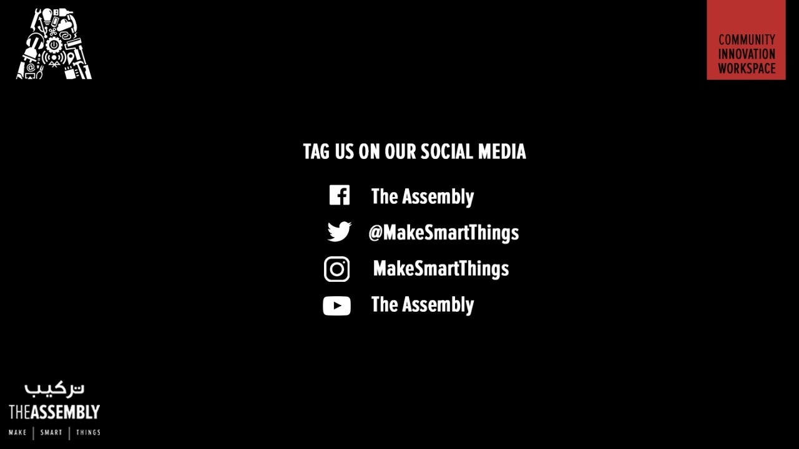
THANK YOU
THANK YOU

